Slide 1
Urgensi Riset Implementasi untuk Penelitian Kebijakan Kesehatan
Ari Probandari
Guru Besar
Fakultas Kedokteran, Universitas Sebelas Maret, Surakarta

Slide 2
Kerangka Presentasi
Apakah riset implementasi itu?
Apa irisan penelitian kebijakan dan riset implementasi?
Mengapa perlu melakukan pendekatan riset implementasi dalam penelitian kebijakan?

Slide 3
Bacaan/Sumber Belajar
Access and Delivery Partnership. TDR Implementation research toolkit, second edition. https://adphealth.org/irtoolkit/
Bob Hudson, David Hunter & Stephen Peckham (2019) Policy failure and the policy-implementation gap: can policy support programs help?, Policy Design and Practice, 2:1, 1-14, DOI: 10.1080/25741292.2018.1540378
Crable, E.L., Lengnick-Hall, R., Stadnick, N.A. et al. Where is “policy” in dissemination and implementation science? Recommendations to advance theories, models, and frameworks: EPIS as a case example.Implementation Sci 17, 80 (2022). https://doi.org/10.1186/s13012-022-01256-x)
Carroll, C., Patterson, M., Wood, S., Booth, A., Rick, J., & Balain, S. (2007). A conceptual framework for implementation fidelity. Implementation Science, 2(1). https://doi.org/10.1186/1748-5908-2-40
David HP, Nhan T.T, Taghreed A. Implementation research in health: a practical guide. Alliance for Health Policy and Systems Research, World Health Organization, 2013. https://iris.who.int/bitstream/handle/10665/91758/9789241506212_eng.pdf?sequence=1

Slide 4
Bacaan/Sumber Belajar
Damschroder, L.J., Aron, D.C., Keith, R.E. et al. Fostering implementation of health services research findings into practice: a consolidated framework for advancing implementation science. Implementation Sci 4, 50 (2009). https://doi.org/10.1186/1748-5908-4-50
Damschroder, L.J., Reardon, C.M., Widerquist, M.A.O. et al. The updated Consolidated Framework for Implementation Research based on user feedback. Implementation Sci 17, 75 (2022). https://doi.org/10.1186/s13012-022-01245-0
Damschroder, L.J., Reardon, C.M., Opra Widerquist, M.A. et al. Conceptualizing outcomes for use with the Consolidated Framework for Implementation Research (CFIR): the CFIR Outcomes Addendum. Implementation Sci 17, 7 (2022). https://doi.org/10.1186/s13012-021-01181-5
Massive open online course (MOOC) on implementation research: infectious diseases of poverty. https://tdr.who.int/home/our-work/strengthening-research-capacity/massive-open-online-course-(mooc)-on-implementation-research

Slide 5
Bacaan/Sumber Belajar
Purtle, J., Moucheraud, C., Yang, L.H. et al. Four very basic ways to think about policy in implementation science. Implement Sci Commun 4, 111 (2023). https://doi.org/10.1186/s43058-023-00497-1
Peters DH, Adam T, Alonge O, Agyepong I A, Tran N. Implementation research: what it is and how to do it BMJ 2013; 347:f6753 doi:10.1136/bmj.f6753
Proctor E, Silmere H, Raghavan R, Hovmand P, Aarons G, Bunger A, Griffey R, Hensley M. Outcomes for implementation research: conceptual distinctions, measurement challenges, and research agenda. Adm Policy Ment Health. 2011 Mar;38(2):65-76. doi: 10.1007/s10488-010-0319-7.
Schell, S.F., Luke, D.A., Schooley, M.W. et al. Public health program capacity for sustainability: a new framework. Implementation Sci 8, 15 (2013). https://doi.org/10.1186/1748-5908-8-15

Slide 6
Apakah riset implementasi itu? Apa irisan penelitian kebijakan dan riset implementasi?

Slide 7
Riset Implementasi
“ The basic intent of implementation research is to understand not only what is and isn’t working, but how and why implementation is going right or wrong, and testing approaches to improve it.”
(WHO TDR)

Slide 8
Riset Implementasi
“IR is the systematic approach to understanding and addressing barriers to effective and quality delivery of health interventions, strategies, and policies.”
(WHO TDR)

Slide 9
Riset Implementasi
CONTEXT
Intervention or Technology
Barriers
Systems Failure
Implementation Intervention
Improvements in health (patient outcomes)
“ how and why implementation is going right or wrong”

Slide 10
Riset Implementasi
testing approaches to improve it
Intervention or Technology
Barriers
System Failure
Implementation Strategy
Improvements in health (patient outcomes)
Implementation Outcomes
Feasibility
Fidelity
Penetration
Acceptability
Sustainability
Uptake
Costs
Systems failure
MULTIPLE decisions
“ how and why implementation is going right or wrong”
Systems failure

Slide 11
Karakteristik Riset Implementasi

Slide 12
Luaran Implementasi (Implementation Outcome)
Konstruk/domain yang mencerminkan efek/hasil dari suatu proses implementasi intervensi/teknologi.
Dapat digunakan untuk mengukur keberhasilan/kegagalan suatu proses implementasi
‘Intermediate outcome’ dari suatu efektivitas intervensi pada populasi/individu (status kesehatan, quality of life)

Slide 13
Definisi Luaran Implementasi [1]
Implementation Outcome | Working Definition* | Related terms**
Acceptability | The perception among stakeholders (e.g. consumers, providers, managers, policy-makers) that an intervention is agreeable | Related factors: (e.g. Comfort, Relative advantage, Credibility)
Adoption | The intention, initial decision, or action to try to employ a new intervention | Uptake, Utilization, Intention to try,
Appropriateness | The perceived fit or relevance of the intervention in a particular setting or for a particular target audience (e.g. provider or consumer) or issue | Relevance, Perceived fit, Compatibility, Perceived usefulness or suitability
Feasibility | The extent to which an intervention can be carried out in a particular setting or organization | Practicality, Actual fit, Utility, Trialability

Slide 14
Definisi Luaran Implementasi [2]
Implementation Outcome | Working Definition* | Related terms**
Fidelity | The degree to which an intervention was implemented as it was designed in an original protocol, plan, or policy | Adherence, Delivery as intended, Integrity, Quality of delivery, Intensity or dosage of delivery
Implementation cost | The incremental cost of the implementation strategy (i.e. how the services are delivered in a particular setting); including the cost of the intervention itself. | Marginal cost, Total cost***
Penetration/ Coverage | Extent to which a practice or program is integrated within a service settings and system (niche saturation). The degree to which the population that is eligible to benefit from an intervention actually receives it. | Reach, Access, Service Spread or Effective Coverage, Penetration
Sustainability | The extent to which an intervention is maintained or institutionalized in a given setting. | Maintenance, Continuation, Routinization, Institutionalization,

Slide 15
Pengukuran Luaran Implementasi [1]
Implementation Outcomes | Level of Analysis | Salience by Implementation Stage
Acceptability | Individual provider/consumer | Early for adoption Ongoing for penetration Late for sustainability
Adoption | Individual provider Organization/setting | Early to mid
Appropriateness | Individual provider/consumer Organization/setting | Early (prior to adoption)
Feasibility | Individual providers Organization/setting | Early (during adoption)

Slide 16
Pengukuran Luaran Implementasi [2]
Implementation Outcomes | Level of Analysis | Salience by Implementation Stage
Fidelity | Individual provider | Early to mid
Implementation cost | Provider or providing institution | Early for adoption and feasibility Mid for penetration Late for sustainability
Penetration | Organization or setting | Mid to late
Sustainability | Administrators Organization or setting | Late

Slide 17
IR Framework yang Sering Digunakan [1]
Consolidated Framework for Implementation Research (CFIR)
RE-AIM
NIRN stages of implementation
ADAPT-ITT
WHO ExpandNet

Slide 18
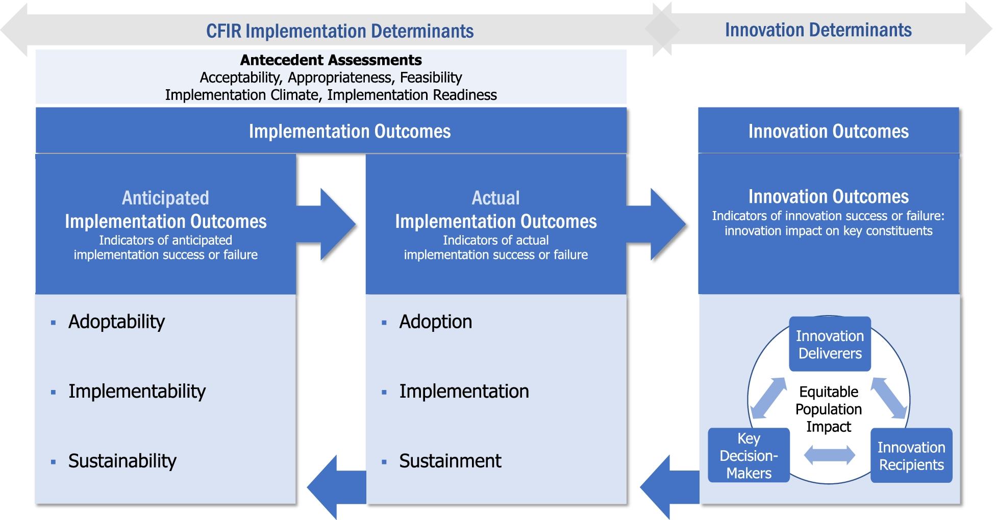
Consolidated Framework for Implementation Research (CFIR) (https://cfirguide.org)
Versi tahun 2009 dan diperbarui tahun 2022
“The CFIR is intended to be used to collect data from individuals who have power and/or influence over implementation outcomes.”

Slide 19
RE-AIM (https://re-aim.org)
Reach
Effectiveness
Adoption
Implementation consistency/cost/adoption
Maintenance/sustainment

Slide 20
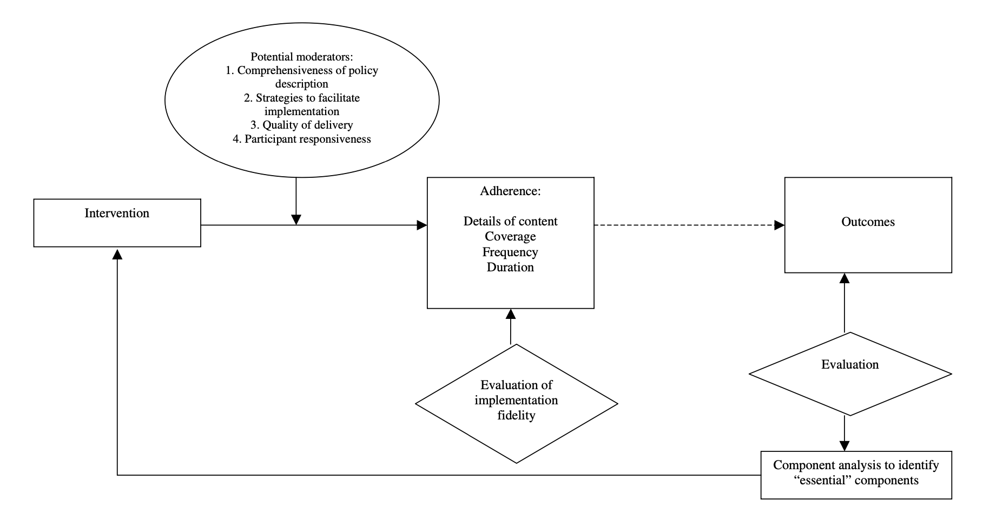
Framework Lain
Implementation fidelity (Carol et al. 2007)

Slide 21
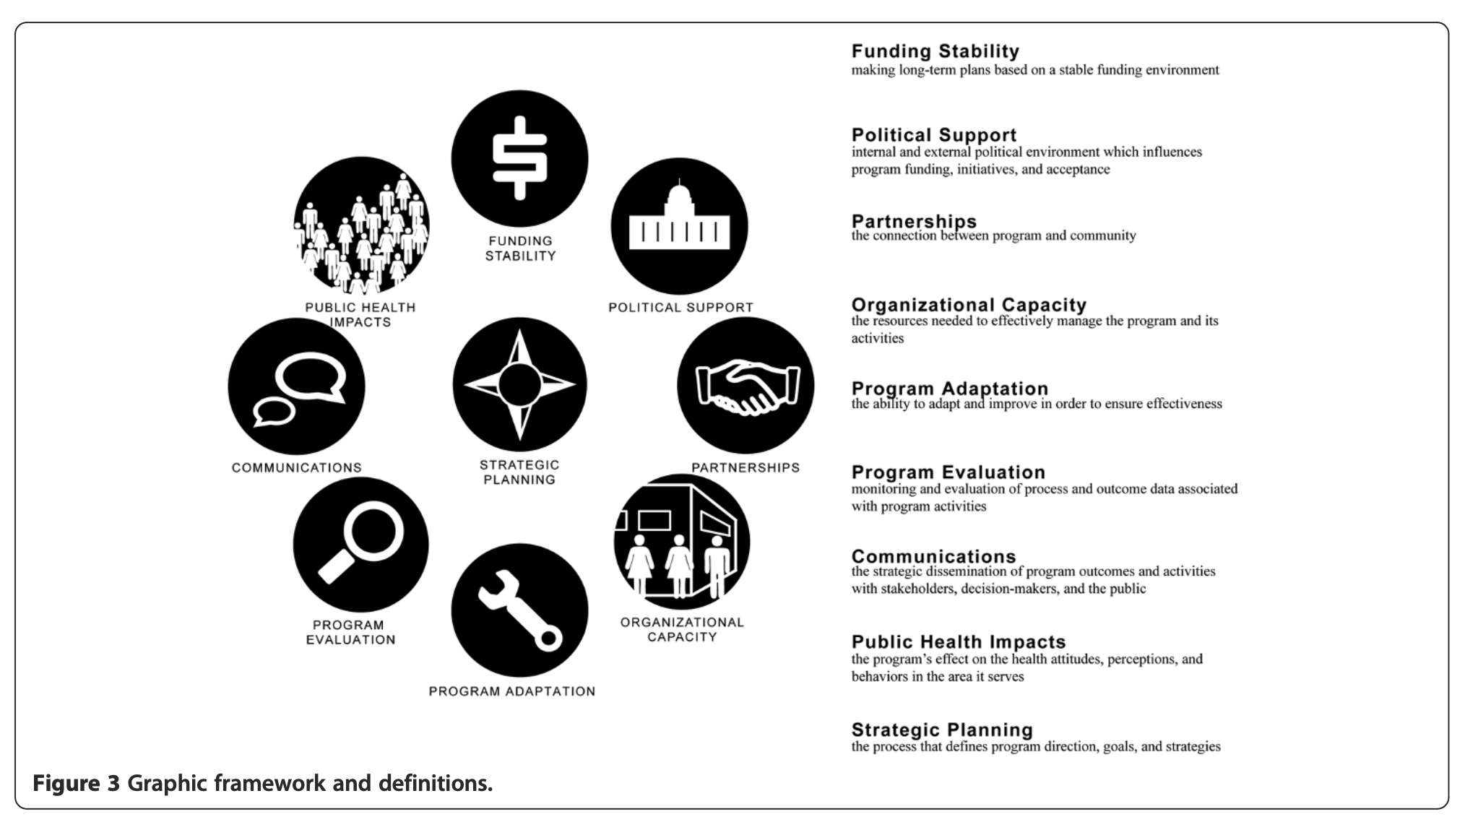
Framework Lain
Implementation sustainability (Schell et al. 2013)

Slide 22
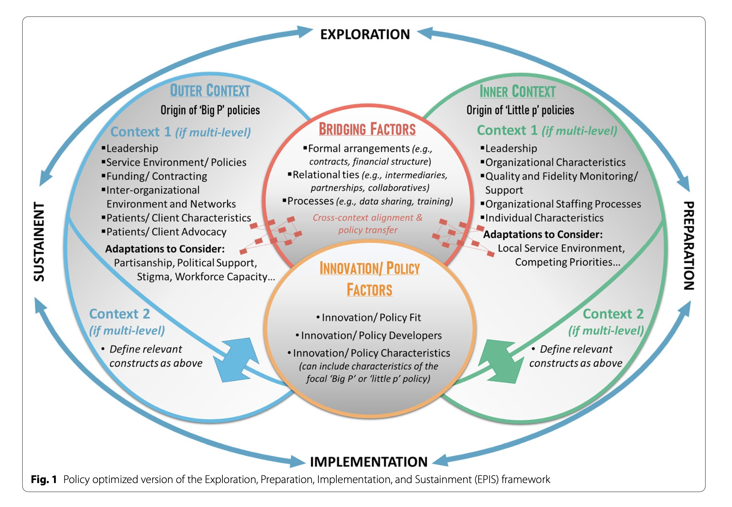
Framework Lain
EPIS framework
(Crable et al., 2022)

Slide 23
Common study designs in IR
Pragmatic Trials
Effectiveness-Implementation Hybrid Trials
Quality Improvement Studies
Participatory Action Research
Realist Review
Mixed Methods
Stepped Wedge Cluster RCT

Slide 24
Mengapa perlu melakukan pendekatan riset implementasi dalam penelitian kebijakan kesehatan?

Slide 25
Policy Failure
“There is an increasing awareness that policies do not succeed or fall on their own merits. Within the complex systems, it is unclear how best to ensure effective policy design and implementation”
(Hudson et al., 2019)

Slide 26
Why there is an urgency to conduct implementation research approach in policy study?
Purtle et al., 2023

Slide 27
Policy in real-life setting: No one policy size fits all?

Slide 28
Opportunity to apply IR approach in policy studies

Slide 29
Terima Kasih

